Slide 1
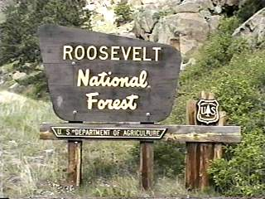
Predicting Forest Cover Types from Cartographic Variables
Sierra Costanza, Jon Hunt
Data Mining Final Project
Dec. 19th, 2013

Slide 2
Motivation
Accurate natural resource inventory information is vital to land management agencies, and forest cover type is one of the most basic characteristics recorded in those inventories
It may be time consuming to directly record the data or estimate it using remote sensing, and/or often economically or legally impossible to obtain the data from lands that are not under the agency’s control
Blackard and Dean (1999) study compared the performance of a feedforward artificial neural network model to a Gaussian discriminant analysis (LDA) for predicting forest cover type in 4 wilderness areas of the Roosevelt National Park in CO using cartographic variables only.
→Will our methods perform better?

Slide 3
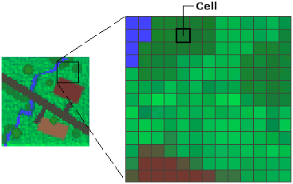
Description of the Dataset
Study area (4 wilderness areas within Roosevelt National Park): Rawah (72,313 acres), Comanche Peak (67,680 acres), Neota (9,647 acres), Cache la Poudre (9,433 acres). Chosen because fairly undisturbed.
Digital spatial data obtained from the US Geological Survey (USGS) and the US Forest Service (USFS) were used to derive independent variables.
Elevation was obtained directly from USGS digital elevation model (DEM) data, based on 30x30m raster cells. This was used to standardize all remaining data.
Each observation in this study represents a unique 30x30m raster cell that corresponds to the DEM data.
12 features, 54 columns of data, 581,012 instances.
Raster cells
Source: http://webhelp.esri.com/arcgisdesktop/9.2/index.cfm?TopicName=What_is_raster_data%3F

Slide 4
Description of the Dataset - Features
Feature | Variable Name | Description
1. Elevation | elevation | Measured in meters (m)
2. Aspect | aspect | Azimuth from true north
3. Slope | slope | Measured in º (degrees)
4. Horizontal distance to water | hydro_hordist | Horizontal distance to nearest surface water feature (m)
5. Vertical " | hydro_vertdist | Vertical distance to nearest surface water feature (m)
6. Horizontal distance to roadway | roadway_hordist | Horizontal distance to nearest roadway (m)
7. Incident sunlight | hillshade_9(12,15) | 3 features; relative measures of incident sunlight at 9am, 12pm and 3pm on the summer solstice (index)
10. Nearest ignition point | fire_hordist | Horizontal distance to nearest historic wildfire ignition point (m)
11. Wilderness area | WAD1-4 | Designation, 4 binary values, one for each wilderness area
12. Soil Type | Soil1-40 | Designation, 40 binary values, one for each soil type

Slide 5
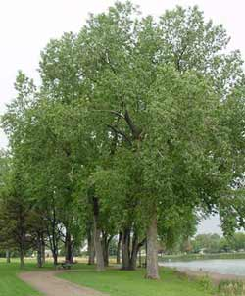
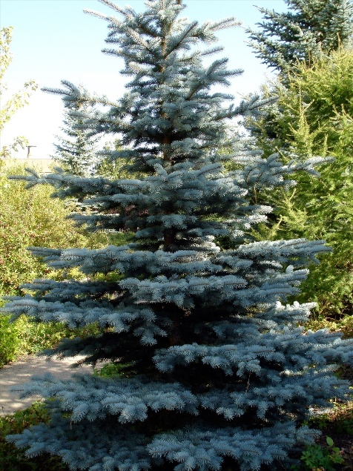
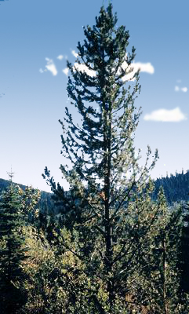
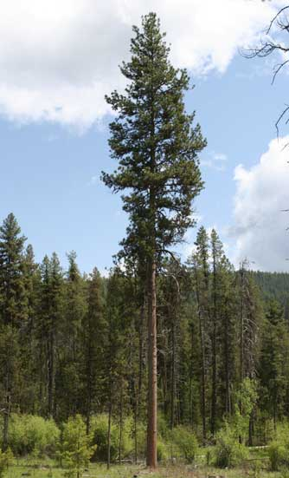
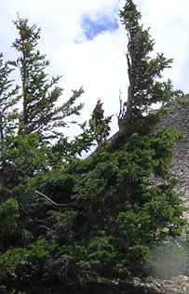
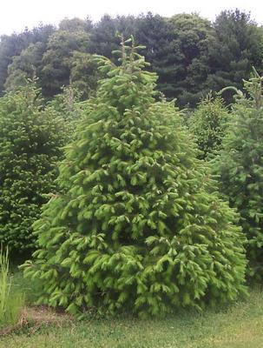
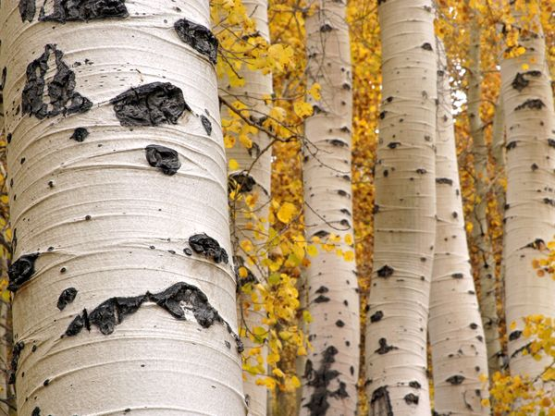
Cover Type Classes (most dominant trees)
1: Spruce
4: Cottonwood/Willow
7: Krummholz
2: Lodgepole Pine
3: Ponderosa Pine
5: Aspen
6: Douglas Fir

Slide 6
Class Distribution in the Dataset
Training sets were built by selecting both an equal number of class instances and a proportional number of class instances

Slide 7
Classification Methods Used
LDA (replicated the study and tried to improve)
K-Nearest Neighbors
Logistic Regression
Naïve Bayes
Single Classification Tree and Random Forests
A note on pre-processing:
No missing values
Categorical features (e.g., wilderness area, soil type) were already encoded
Correlation matrix among features was examined
Most of what was needed was a reduction in size – sampling was used
One-vs.-all approach to build 7 binary classifiers for Naïve Bayes and Logistic Regression classification methods
Repeated random subsampling validation was used to measure performance

Slide 8
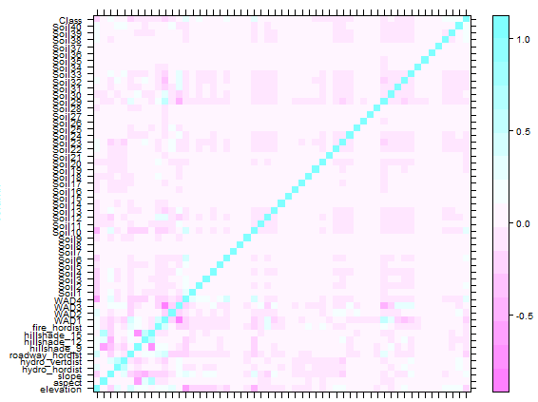
Correlation Matrix
Few significantly correlated variables identified

Slide 9
Linear Discriminant Analysis
Training and test set size:
Equal: Proportional:
1,620 instances per class selected as training set as this represents ~60% of observations available for least numerous cover type (cottonwood/willow), as recommended by Anderson et al.,1996
Omitted Soil7, Soil8, and Soil14 due to sparseness conflicts with LDA (<0.1%)
Ran the same parameters as Blackard and Dean, 1999 and replicated the ~58% percent classification accuracy
10 random simulations used for validation
Misclassification error:
Equal: 42.67% ± 0.92%
Proportional: 32.51% ± 0.54%
 | Training Set | Testing Set
# Instances | 11,340 | 11,340
# Instances per class | 1,620
Training Set | Testing Set
11,340 | 11,340
4,135 | 5,530 | 698 | 53 | 185 | 339 | 400

Slide 10
K-Nearest Neighbors
Training and test set size:
Equal: Proportional:
K=1 selected after cross-validation k-value optimization
10 random simulations used for validation
Misclassification error:
Equal: 34.70% ± 0.80%
Proportional: 19.80% ± 0.43%
 | Training Set | Testing Set
# Instances | 11,340 | 11,340
# Instances per class | 1,620
Training Set | Testing Set
11,340 | 11,340
4,135 | 5,530 | 698 | 53 | 185 | 339 | 400

Slide 11
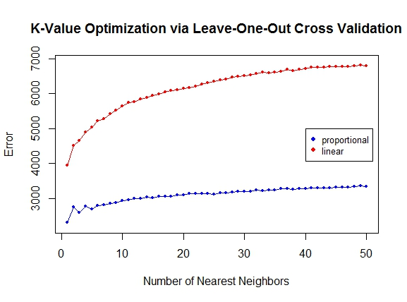
Choice of K K optimization via leave-one-out cross validation

Slide 12
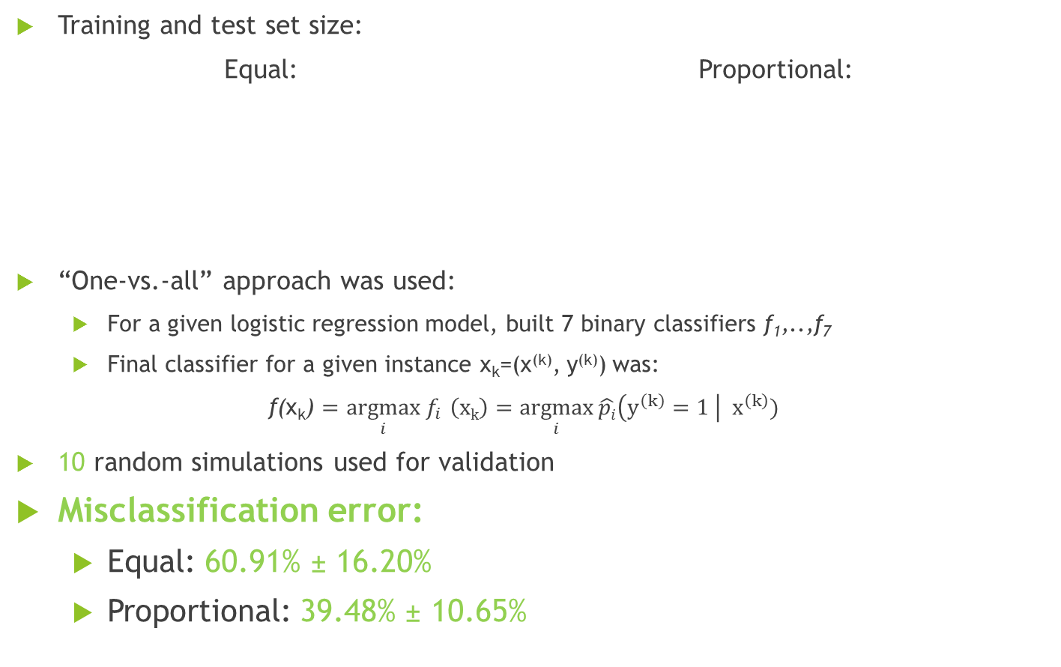
Logistic Regression
Training and test set size:
Equal: Proportional:
“One-vs.-all” approach was used:
For a given logistic regression model, built 7 binary classifiers f₁,..,f₇
Final classifier for a given instance x_{k}=(x^{(k)}, y^{(k)}) was:
f(x_{k}) = $\underset{i}{argmax}{f_{i }}\left(xk\right)=\underset{i}{argmax}{\hat{pi}\left(y^{\left(k\right)}=1 \right|{ x}^{\left(k\right)})}$
10 random simulations used for validation
Misclassification error:
Equal: 60.91% ± 16.20%
Proportional: 39.48% ± 10.65%
 | Training Set | Testing Set
# Instances | 11,340 | 11,340
# Instances per class | 1620
Training Set | Testing Set
11,340 | 11,340
4,135 | 5,530 | 698 | 53 | 185 | 339 | 400

Slide 13
Logistic Regression: StepAIC Model Selection
Commonly Omitted Variables
Soil7
Soil8
Soil15
Soil27
Soil28
Soil36
Model | Misclassification Rate | Runtime (Sec)
Original | 45.80% | 262.71
Post-StepAIC | 47.43% | 230.65
Model Selection (Akaike Information Criterion) via Stepwise Algorithm
Conclusion: No significant benefit from new model

Slide 14
Naïve Bayes
Training and test set size:
Equal: Proportional:
Also used a one-vs.-all approach
Model excluded features with 0 variance in the training set (e.g. Soil8, WAD4, etc.), reducing available information
10 random simulations used for validation
Misclassification error:
Equal: 54.60% ± 1.00%
Proportional: 57.24% ± 0.96%
 | Training Set | Testing Set
# Instances | 11,340 | 11,340
# Instances per class | 1620
Training Set | Testing Set
11,340 | 11,340
4,135 | 5,530 | 698 | 53 | 185 | 339 | 400

Slide 15
Single Classification Tree
Training and test set size:
Equal: Proportional:
Used information as the splitting criterion (Gini index did not produce a significant difference in classification error based on a few runs; could have used either)
The algorithm prunes automatically by performing a cross-validation within the training set and selecting an optimal “complexity parameter”
50 random simulations used for validation
Misclassification error:
Equal: 57.09% ± 4.50%
Proportional: 32.92% ± 0.34%
 | Training Set | Testing Set
# Instances | 11,340 | 569,672
# Instances per class | 1620
Training Set | Testing Set
11,340 | 569,672
4,135 | 5,530 | 698 | 53 | 185 | 339 | 400

Slide 16
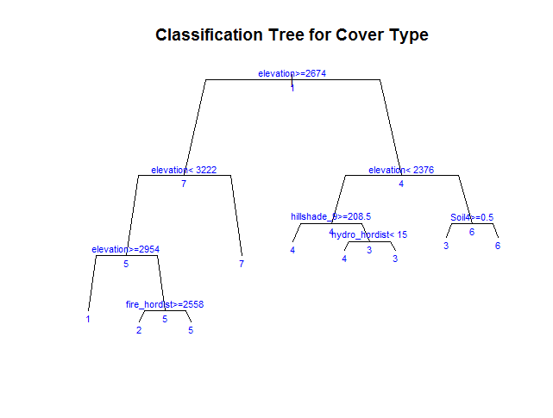
Tree Visualization (Equal Approach)
High
Elevation
Most of the separation is done based on elevation. Seems to match the actual data (next slide) quite accurately!
Medium
Elevation
Low
Elevation

Slide 17

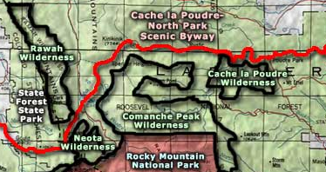
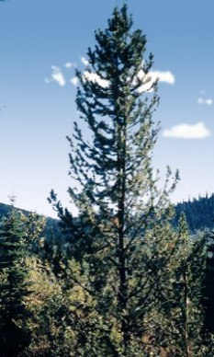
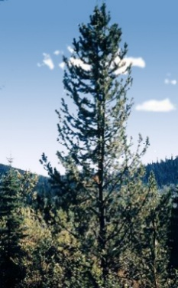
Cover Type Classes and Actual Locations
Lowest
Elevation
Medium
Elevation
1
4
3
Most unique with respect to overall dataset
6
5
2
Source: http://www.sangres.com/colorado/wilderness/neota.htm#.Uq9io-JHCI9
Medium
Elevation
Highest
Elevation
1
5
1
2

Slide 18
Random Forests
Training and test set size:
Equal: Proportional:
20 random simulations used for validation
Misclassification error:
Equal: 28.36% ± 1.07% - Best so far
Proportional: 17.66% ± 0.98%
 | Training Set | Testing Set
# Instances | 11,340 | 11,340
# Instances per class | 1620
Training Set | Testing Set
11,340 | 11,340
4,135 | 5,530 | 698 | 53 | 185 | 339 | 400

Slide 19
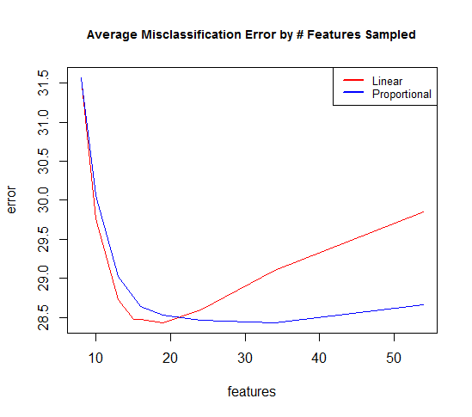
Random Forests: Optimal # Features to Sample
Used information from the single classification tree (8 variables were optimal) to decide how many features to sample when building the forest. 8 would be the minimum, and we tried 8 more integer values between 8 and 54.
The minimum average classification errors were reported (Equal=16 features, proportional=34 features).

Slide 20
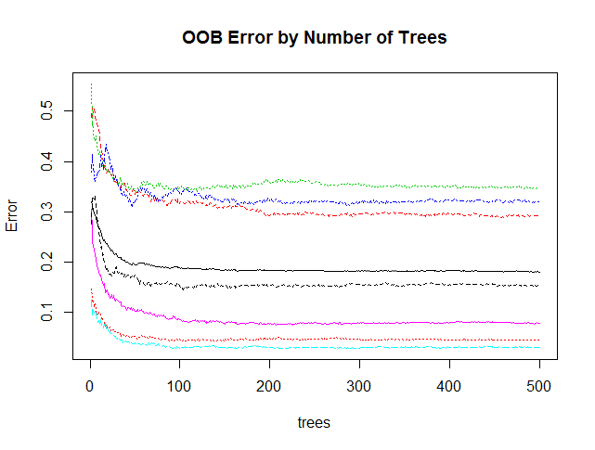
Random Forests: Optimal # Trees
We plotted the “out-of-bag” (OOB) error by number of trees (t), which is the misclassification error from the algorithm's random holding out of ≈1/3 of the training data to test the model with t trees on the remaining data
We chose 300 (where error stabilized, to be on the safe side)

Slide 21
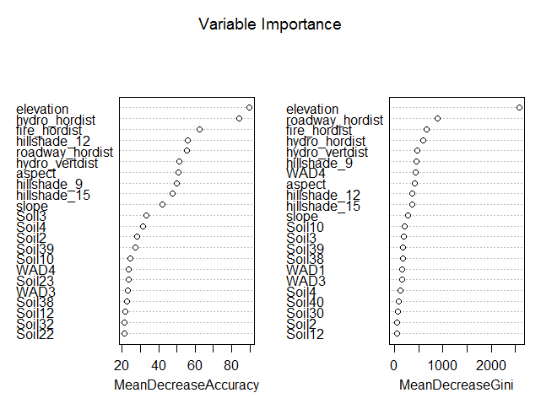
Results: Variable Importance (Trees)
Mean Dec. Accuracy:
How much inclusion of the variable reduces the overall class. error
Mean Dec. Gini:
How well the variable splits the data into the classes

Slide 22
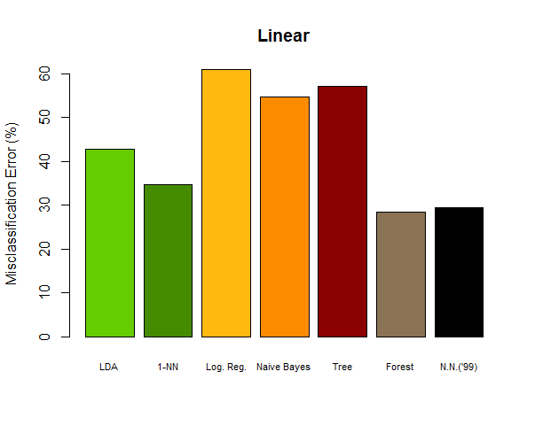
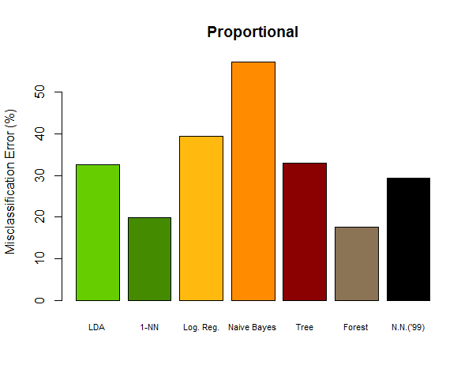
Results: Misclassification Error Comparisons

Slide 23
Results: Confusion Matrices Example from 1-Nearest Neighbor: 569,672 size test set
Equal (more error overall)
Predicted Class
 | 1 | 2 | 3 | 4 | 5 | 6 | 7 | class.err
1 | 145,924 | 39,096 | 500 | 3 | 5,818 | 445 | 18,434 | 30.59%
2 | 55,584 | 175,418 | 10,164 | 195 | 28,468 | 8,152 | 3,700 | 37.72%
3 | 39 | 596 | 27,151 | 1,877 | 488 | 3,980 | 3 | 20.46%
4 | 0 | 0 | 24 | 1,077 | 0 | 26 | 0 | 4.44%
5 | 44 | 124 | 53 | 0 | 7,622 | 28 | 2 | 3.19%
6 | 12 | 218 | 1,095 | 592 | 192 | 13,638 | 0 | 13.39%
7 | 411 | 73 | 0 | 0 | 1 | 0 | 18,405 | 2.57%
True Class
Proportional (less error overall)
Less frequent classes have more error
For other methods, matrix was often was only 2 columns due to high frequency of classes 1 & 2
Predicted Class
 | 1 | 2 | 3 | 4 | 5 | 6 | 7 | class.err
1 | 165,558 | 38,063 | 151 | 0 | 565 | 86 | 3,282 | 20.29%
2 | 35,210 | 232,266 | 3,717 | 24 | 3,977 | 2,176 | 401 | 16.38%
3 | 91 | 3,896 | 26,290 | 795 | 346 | 3,638 | 0 | 25.01%
4 | 0 | 8 | 1,115 | 1,237 | 0 | 334 | 0 | 54.08%
5 | 599 | 3,567 | 172 | 0 | 4,807 | 141 | 22 | 48.36%
6 | 96 | 2,439 | 3,565 | 309 | 106 | 10,513 | 0 | 38.26%
7 | 4,799 | 813 | 0 | 0 | 5 | 0 | 14,493 | 27.93%
True Class

Slide 24
Conclusions
Equal approach had higher error than proportional for all methods (except Naïve Bayes), but had about equal distribution of error between classes. Proportional had much higher error among less frequent classes.
Binary/sparse variables less useful than other variables in most models; elevation was the most useful in tree models
Logistic regression and Naïve Bayes models performed worst, most likely due to sparseness of the binary features and and/or contradictions and complexity introduced via the one-vs-all approach to multiclass classification
Random forest algorithm (300 trees, 15-20 features sampled) was the only one that outperformed the neural networks algorithm; 1-nearest neighbor method also performed well

Slide 25
Bibliography
Data from: http://archive.ics.uci.edu/ml/datasets/Covertype
Blackard J, Dean D. 1999. Comparative accuracies of artificial neural networks and discriminant analysis in predicting forest cover types from cartographic variables. Computers and Electronics in Agriculture [Internet]. 24(3):131-151. Available from: http://www.sciencedirect.com/science/article/pii/S0168169999000460

